Slide 1
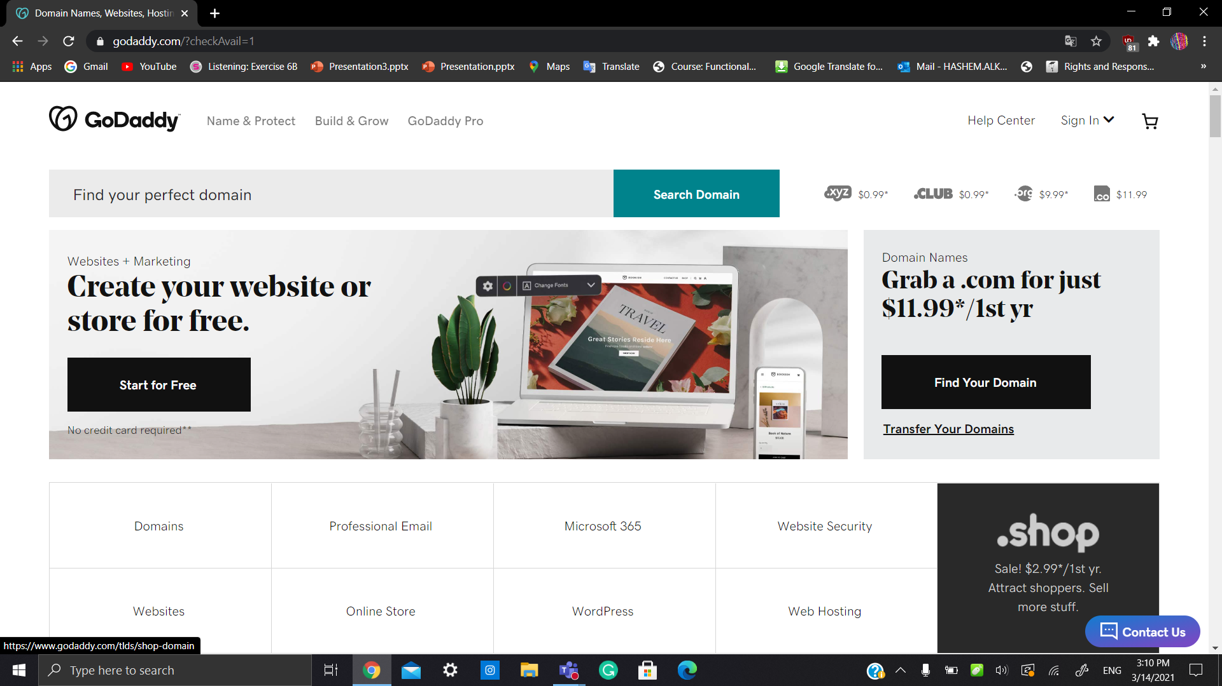
Step 1.Go to a domain name provider such as GoDaddy.com.

Slide 2

Step 2.Search for the domain name you want

Slide 3
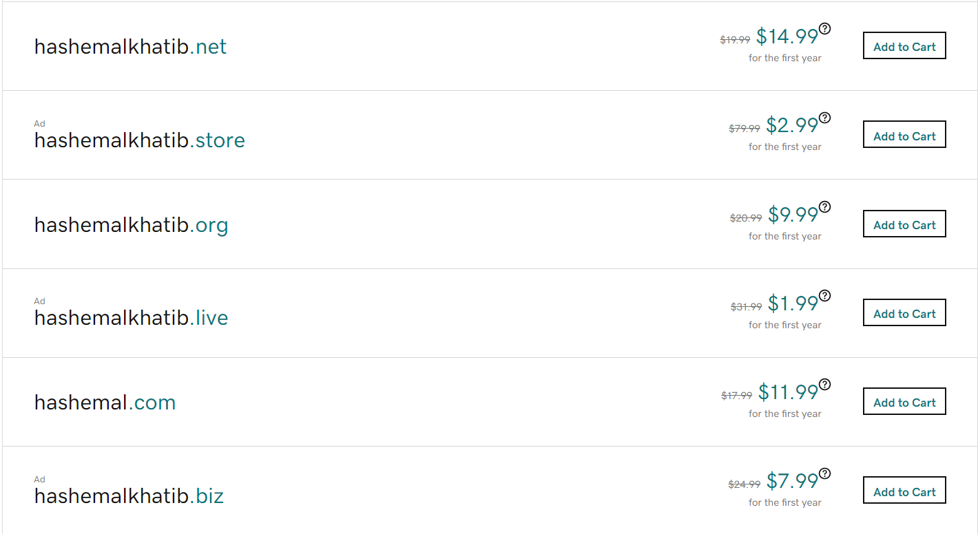
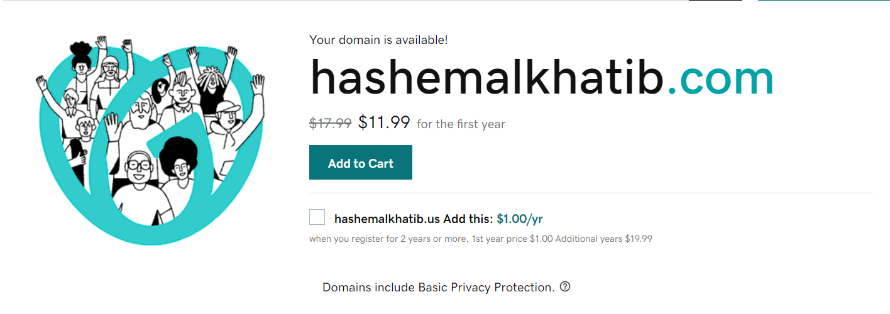
Step 3.Chose the domain name you need and preferer.

Slide 4
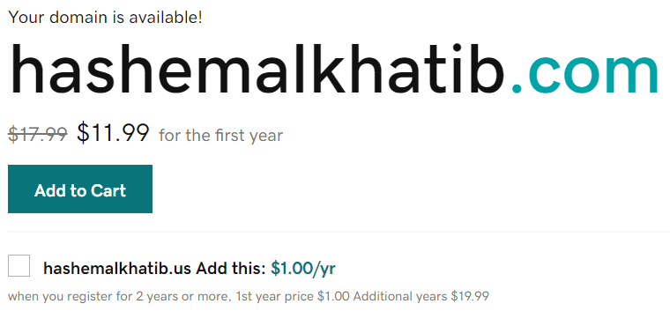
Step 4. After choosing the domain name press Add to Cart.

Slide 5
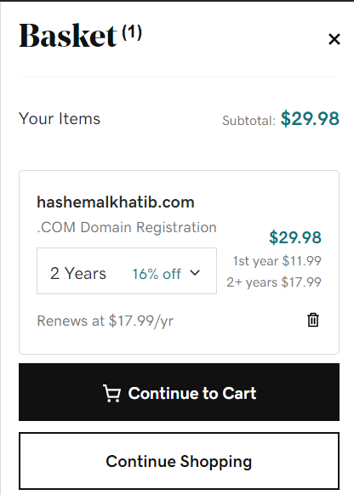
Step 5. Press continue to cart after choosing the registration choices.

Slide 6
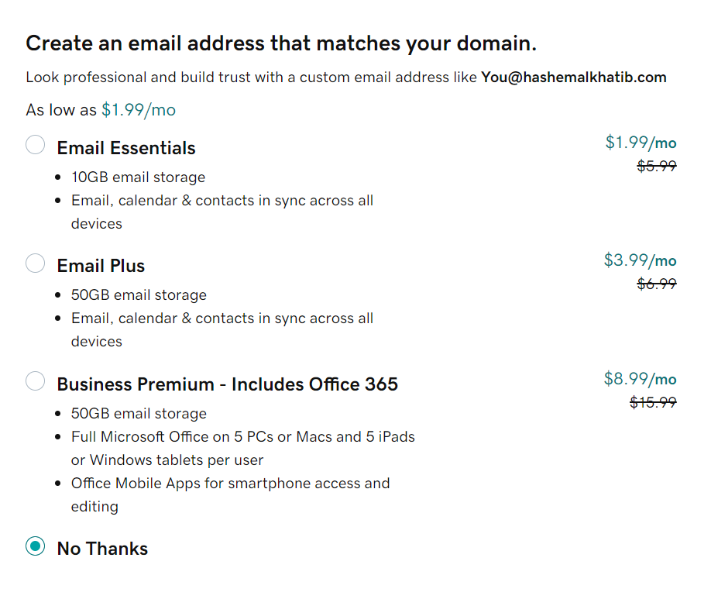
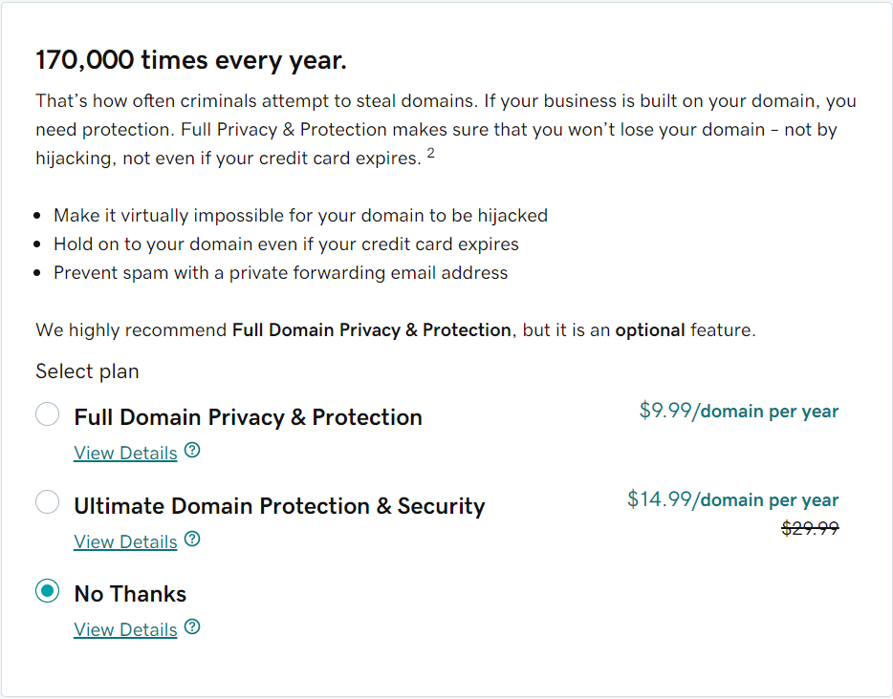
Step 6. Go daddy gives you the choice to upgrade you account choose No Thanks as a starter.

Slide 7
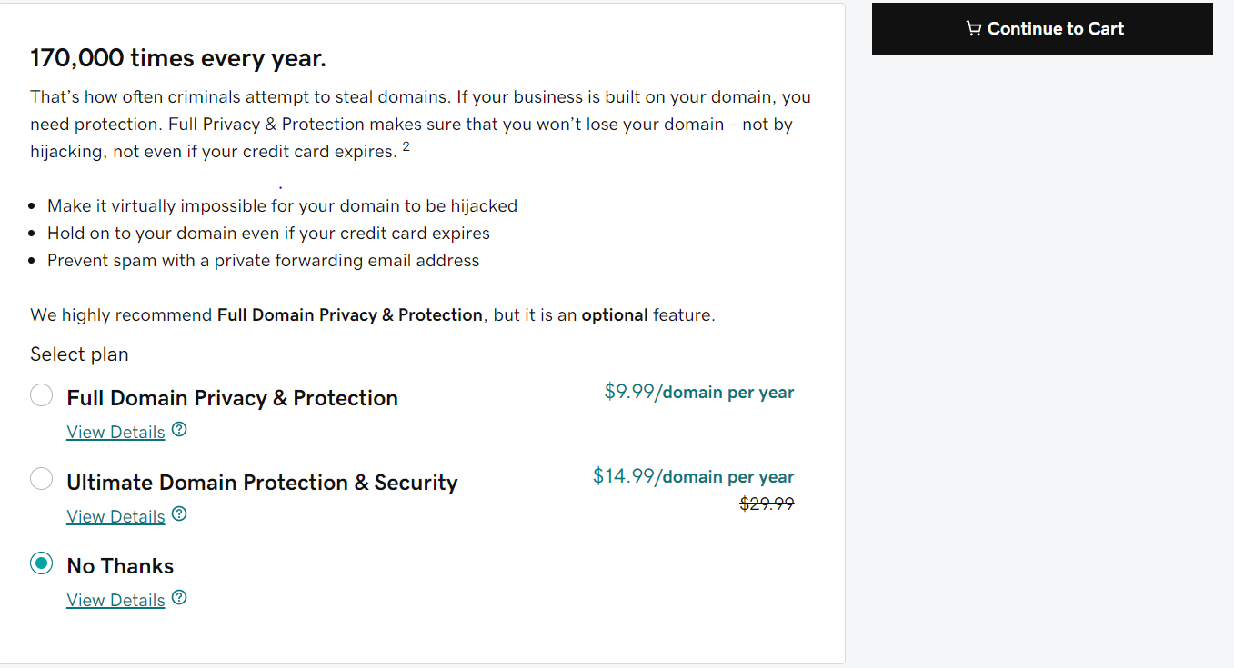
step7. Press continue to cart.

Slide 8
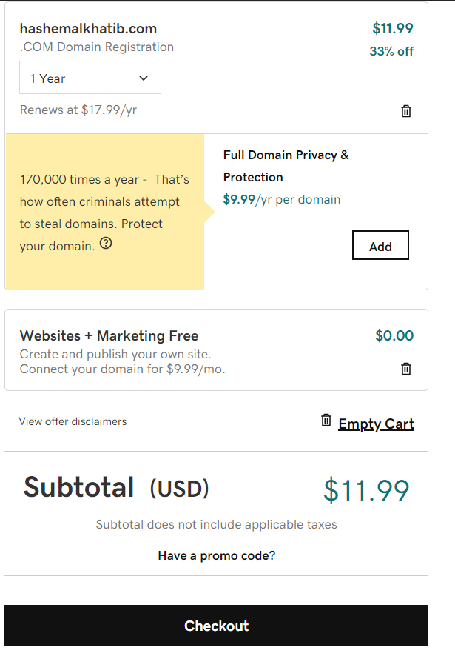
Step 8.You can Add a Full Domain Privacy & Protection or press Checkout to proceed

Slide 9
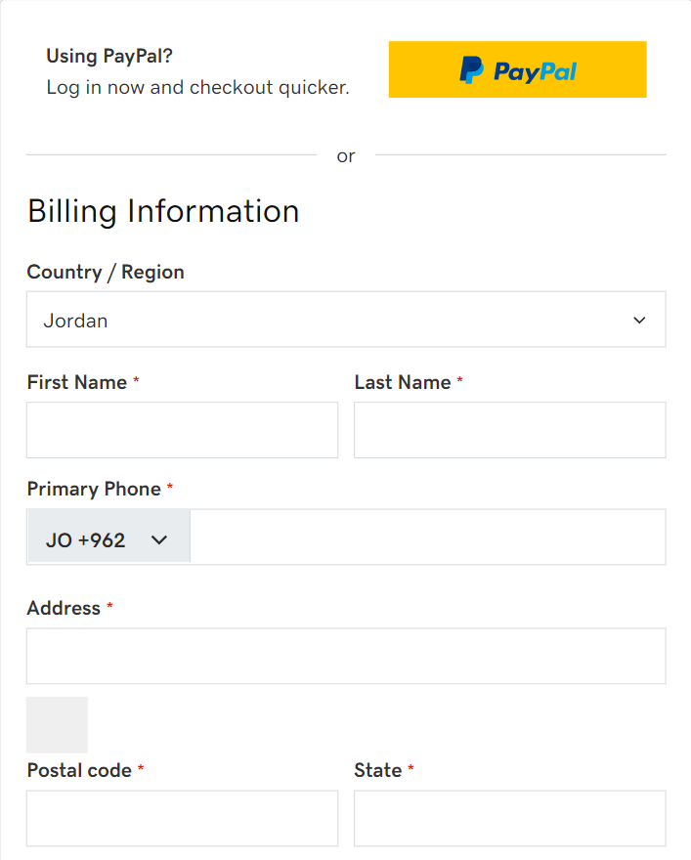
Step 9.Sign in If it is your first time then choose you payment method, enter you payment personal information's and you will own your domain name.

Slide 10
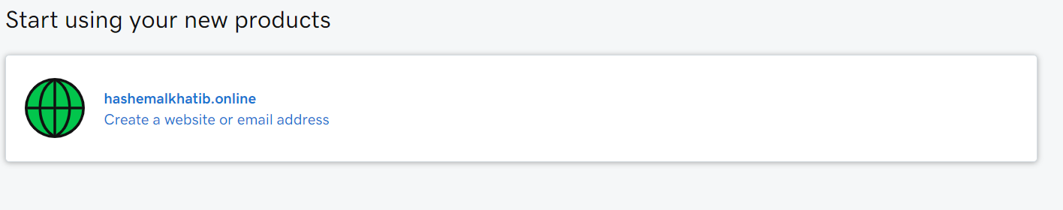
My domain name:

